Slide 1
HKN CS 61A Midterm 2 Review
Michael, Sean, Danny

Slide 2
Hello!
Hosted by HKN (hkn.eecs.berkeley.edu)
Office Hours:
Time: 11AM to 5PM
Location: 290 Cory, 345 Soda
Check our website: (hkn.eecs.berkeley.edu/tutor)
for exam archive, course guide, course surveys, tutoring schedule
[Disclaimer: This is an unofficial review session and HKN is not affiliated with this course. All of the topics we are reviewing will reflect the material you have covered, our experiences in CS61A, and past midterms. We make no promise that what we cover will necessarily reflect the content of the midterm.]

Slide 3
Agenda
Lists, Tuples, Dictionaries, Sequences
Data Abstraction
Nonlocal
Object-Oriented Programming
Inheritance
Linked Lists
Trees
Orders of Growth
Tell us what you want: http://tinyurl.com/yc9wh49s

Slide 4
Iterables
Lists: Sequences that are mutable. We can add, remove, and change the items of a list.
Tuples: Sequences that are immutable. We cannot change the items in a tuple; we can only create new tuples.
Dictionaries: Objects that map keys to values. Remember that the keys are unordered and unique!
Ranges: Objects that represent an interval of elements between two values.
Notes:
List Methods...
list.append(x)
Add an item to the end of the list; equivalent to a[len(a):] = [x].
list.extend(L)
Extend the list by appending all the items in the given list; equivalent to a[len(a):] = L.
list.insert(i, x)
Insert an item at a given position. The first argument is the index of the element before which to insert, so a.insert(0, x) inserts at the front of the list, and a.insert(len(a), x) is equivalent to a.append(x).
list.remove(x)
Remove the first item from the list whose value is x. It is an error if there is no such item.
list.pop([i])
Remove the item at the given position in the list, and return it. If no index is specified, a.pop() removes and returns the last item in the list. (The square brackets around the i in the method signature denote that the parameter is optional, not that you should type square brackets at that position. You will see this notation frequently in the Python Library Reference.)
list.index(x)
Return the index in the list of the first item whose value is x. It is an error if there is no such item.
list.count(x)
Return the number of times x appears in the list.
list.sort(cmp=None, key=None, reverse=False)
Sort the items of the list in place (the arguments can be used for sort customization, see sorted() for their explanation).
list.reverse()
Reverse the elements of the list, in place.

Slide 5
Iterables
List Methods...
list.append(x) Add an item to the end of the list; equivalent to a[len(a):] = [x].
list.extend(L) Extend the list by appending all the items in the given list; equivalent to a[len(a):] = L.
list.insert(i, x) Insert an item at a given position. The first argument is the index of the element before which to insert, so a.insert(0, x) inserts at the front of the list, and a.insert(len(a), x) is equivalent to a.append(x).
list.index(x) Return the index in the list of the first item whose value is x. It is an error if there is no such item.
list.count(x) Return the number of times x appears in the list.
list.remove(x) Remove the first item from the list whose value is x. It is an error if there is no such item.
list.pop([i]) Remove the item at the given position in the list, and return it. If no index is specified, a.pop() removes and returns the last item in the list. (The square brackets around the i in the method signature denote that the parameter is optional, not that you should type square brackets at that position. You will see this notation frequently in the Python Library Reference.)
list.sort(cmp=None, key=None, reverse=False) Sort the items of the list in place (the arguments can be used for sort customization, see sorted() for their explanation).
list.reverse()
Reverse the elements of the list, in place.
Notes:
List
x += [2] mutates
x = x + [2] will create a new list

Slide 6
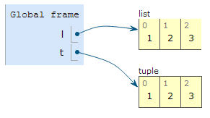
Box & Pointer Diagrams
>>> l = [1, 2, 3]
>>> t = (1, 2, 3)
What's the difference?
Notes:
Lis is immutable and tuples aren’t

Slide 7
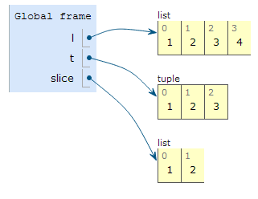

Box & Pointer Diagrams
append() mutates the original list.
>>> l = [1, 2, 3]
>>> t = (1, 2, 3)
>>> slice = l[:2]
>>> l.append(4)
Slicing creates a new list / tuple!

Slide 8
Draw the Box & Pointer Diagram!
r = ([1, 2, 1, 2],)
s = list(r)
t = r
r[0][2] = t[0]
s[0] = r[0][1:]
s[0][1][2][3] = 4
Notes:
In one element tuple creation, format requires a comma after the element.

Slide 9
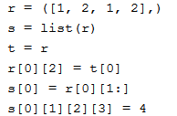
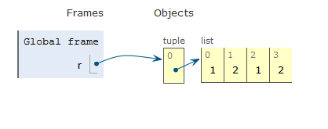
Draw the Box & Pointer Diagram!
Notes:
s makes a shallow copy of r, the tuple

Slide 10
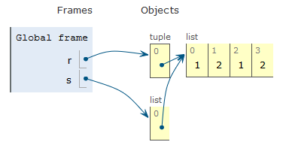
Draw the Box & Pointer Diagram!
Notes:
s makes a shallow copy of r, the tuple

Slide 11
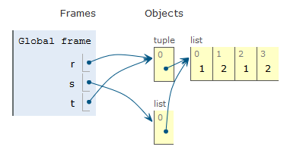
Draw the Box & Pointer Diagram!
Notes:
0th index of r is a pointer to a list and 2nd index of the list will point to the 0th index of t which is the pointer to a list

Slide 12
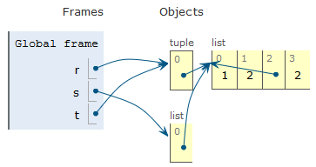
Draw the Box & Pointer Diagram!

Slide 13
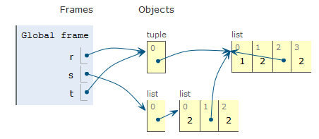
Draw the Box & Pointer Diagram!
Notes:
Austin, s[0] = r[0][1:] makes a shallow copy,right?

Slide 14
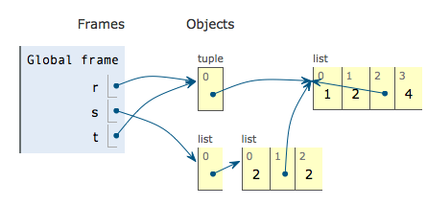
Draw the Box & Pointer Diagram!

Slide 15
Lists : Scope
lst = [1, 2, 3, 4, 5]
def add_five(to_be_changed):
for item in to_be_changed:
item += 5
>> add_five(lst)
>> lst
What would be the result?
Notes:
for item in to_be_changed makes a copy in its frame which gets destroyed

Slide 16
Lists : Scope
lst = [1, 2, 3, 4, 5]
def add_five(to_be_changed):
for item in to_be_changed:
item += 5
>> add_five(lst)
>> lst
What would be the result?
[1, 2, 3, 4, 5] because only the local variable item is modified, not the actual elements themselves in lst

Slide 17
Lists : Scope
lst = [1, 2, 3, 4, 5]
def add_five(to_be_changed):
for i in range(0, len(to_be_changed)):
to_be_changed[i] += 5
>> add_five(lst)
>> lst
What would be the result?
[6, 7, 8, 9, 10] yay!
Notes:
visits actual elements

Slide 18
List Comprehensions Example
>>> words = "We love CS61A!".split()
>>> words
['We', 'love', 'CS61A!']
>>> [len(w) for w in words]
______
>>> [w[i:] for w in words for i in [1, 2]]
______

Slide 19
List Comprehensions Example
>>> words = "We love CS61A!".split()
>>> words
['We', 'love', 'CS61A!']
>>> [len(w) for w in words]
[2, 4, 6]
>>> [w[i:] for w in words for i in [1, 2]]
______

Slide 20
List Comprehensions Example
>>> words = "We love CS61A!".split()
>>> words
['We', 'love', 'CS61A!']
>>> [len(w) for w in words]
[2, 4, 6]
>>> [w[i:] for w in words for i in [1, 2]]
['e', '', 'ove', 've', 's61A!', '61A!']

Slide 21
Dictionary Comprehensions
We can use list comprehension to construct dictionaries.
>>> d = {k : v for k, v in [(x, y) for x in range(3) for y in range(4)]}
Remember that dictionary keys are unique!
>>> d
_____

Slide 22
Dictionary Comprehensions
We can use list comprehension to construct dictionaries.
>>> d = {k : v for k, v in [(x, y) for x in range(3) for y in range(4)]}
Remember that dictionary keys are unique!
>>> d
{0: 3, 1: 3, 2: 3}

Slide 23
Dictionary Comprehensions
We can use list comprehension to construct dictionaries.
>>> d = {k : v for k, v in [(x, y) for x in range(3) for y in range(4)]}
For reference, the list is:
[(0, 0), (0, 1), (0, 2), (0, 3), (1, 0), (1, 1), (1, 2), (1, 3), (2, 0), (2, 1), (2, 2), (2, 3)]
We only care about the last instance of the key (bolded). Why?
What would we do if we wanted to have all the values above in the dictionary?

Slide 24
Dictionary Comprehensions
We can use list comprehension to construct dictionaries.
>>> d = {k : v for k, v in [(x, y) for x in range(3) for y in range(4)]}
For reference, the list is:
[(0, 0), (0, 1), (0, 2), (0, 3), (1, 0), (1, 1), (1, 2), (1, 3), (2, 0), (2, 1), (2, 2), (2, 3)]
We only care about the last instance of the key (bolded). Why?
Because dictionary keys are unique.
What would we do if we wanted to have all the values above in the dictionary? The value for each key would be a list.

Slide 25
Sequences
apply_to_all - Takes in a function and a sequence, and applies the function to each element of the sequence.
Input - Function that takes in one argument and any iterable sequence (list, tuple, etc.).
Output - Sequence of the same length as the input.
Example:
>>> apply_to_all(lambda x: x*x, [2, 3, 4])
[4, 9, 16]

Slide 26
Sequences
reduce - Takes in a function, a sequence and an optional initial value, and returns a single combined value. The result is accumulated as you iterate through the list.
Input - Function that takes in two arguments: an iterable sequence (list, tuple, etc.) and an (optional) starting value.
Output - Single element that is determined by combining the elements of the sequence using the input function.
Example:
>>> reduce(lambda so_far, curr: so_far+curr, [2, 3, 4]))
9

Slide 27
Sequences
Given a list, such as [1, 2, 3, 4, 5, 6], we want to reduce the list to a single number that is the 'flattened' version of the list. For example, the output for this particular list would be the number 123456.
>>> from functools import reduce
>>> t = [1, 2, 3, 4, 5, 6]
>>> reduce(______________________________, _____)
123456

Slide 28
Sequences
Given a list, such as [1, 2, 3, 4, 5, 6], we want to reduce the list to a single number that is the 'flattened' version of the list. For example, the output for this particular list would be the number 123456.
>>> from functools import reduce
>>> t = [1, 2, 3, 4, 5, 6]
>>> reduce(lambda so_far, curr: so_far*10 + curr, t)
123456
How?

Slide 29
Sequences
>>> t = [1, 2, 3, 4, 5, 6]
>>> reduce(lambda so_far, curr: so_far*10 + curr, t)
123456
First iteration:
so_far = 1
curr = 2

Slide 30
Sequences
>>> t = [1, 2, 3, 4, 5, 6]
>>> reduce(lambda so_far, curr: so_far*10 + curr, t)
123456
First iteration:
so_far = 1
curr = 2
result = 1*10 + 2 = 12

Slide 31
Sequences
>>> t = [1, 2, 3, 4, 5, 6]
>>> reduce(lambda so_far, curr: so_far*10 + curr, t)
123456
Next iteration:
so_far = 12
curr = 3
result = 12*10 + 3 = 123
and so on to get 123456.

Slide 32
Sequences
>>> cool = 'denero'
>>> story = [cool[i:2*i] for i in range(6)]
>>> story
_____
>>> bro = apply_to_all(len, story)
>>> bro
_____

Slide 33
Sequences
>>> cool = 'denero'
>>> story = [cool[i:2*i] for i in range(6)]
>>> story
['', 'e', 'ne', 'ero', 'ro', 'o']
>>> bro = apply_to_all(len, story)
>>> bro
_____

Slide 34
Sequences
>>> cool = 'denero'
>>> story = [cool[i:2*i] for i in range(6)]
>>> story
['', 'e', 'ne', 'ero', 'ro', 'o']
>>> bro = apply_to_all(len, story)
>>> bro
[0, 1, 2, 3, 2, 1]

Slide 35
Sequences
keep_if - Takes in a function and a sequence, and returns a new sequence that contains only the items for which the function returns True.
Input - Function that takes in one argument which returns True or False, and any iterable sequence (list, tuple, etc.).
Output - Sequence that contains the elements that satisfy the function.
For example:
>>> keep_if(lambda x: x % 2 == 0, [2, 3, 4])
[2, 4]

Slide 36
Sequences
>>> primes = [2, 3, 5, 7, 11]
>>> fib = [0, 1, 1, 2, 3]
>>> is_prime = lambda x: x in primes
>>> apply_to_all(is_prime, keep_if(is_prime, fib))
_____
>>> get_fib = lambda x: fib[x]
>>> apply_to_all(get_fib, keep_if(is_prime, fib))
_____

Slide 37
Sequences
>>> primes = [2, 3, 5, 7, 11]
>>> fib = [0, 1, 1, 2, 3]
>>> is_prime = lambda x: x in primes
>>> apply_to_all(is_prime, keep_if(is_prime, fib)) [2, 3]
_____
>>> get_fib = lambda x: fib[x]
>>> apply_to_all(get_fib, keep_if(is_prime, fib))
_____

Slide 38
Sequences
>>> primes = [2, 3, 5, 7, 11]
>>> fib = [0, 1, 1, 2, 3]
>>> is_prime = lambda x: x in primes
>>> apply_to_all(is_prime, keep_if(is_prime, fib))) [2, 3]
[True, True]
>>> get_fib = lambda x: fib[x]
>>> apply_to_all(get_fib, keep_if(is_prime, fib))
_____

Slide 39
Sequences
>>> primes = [2, 3, 5, 7, 11]
>>> fib = [0, 1, 1, 2, 3]
>>> is_prime = lambda x: x in primes
>>> apply_to_all(is_prime, keep_if(is_prime, fib))) [2, 3]
[True, True]
>>> get_fib = lambda x: fib[x]
>>> apply_to_all(get_fib, keep_if(is_prime, fib)) [2, 3]
_____

Slide 40
Sequences
>>> primes = [2, 3, 5, 7, 11]
>>> fib = [0, 1, 1, 2, 3]
>>> is_prime = lambda x: x in primes
>>> apply_to_all(is_prime, keep_if(is_prime, fib))) [2, 3]
[True, True]
>>> get_fib = lambda x: fib[x]
>>> apply_to_all(get_fib, keep_if(is_prime, fib)) [2, 3]
# intermediate step [get_fib(2), get_fib(3)]

Slide 41
Sequences
>>> primes = [2, 3, 5, 7, 11]
>>> fib = [0, 1, 1, 2, 3]
>>> is_prime = lambda x: x in primes
>>> apply_to_all(is_prime, keep_if(is_prime, fib))) [2, 3]
[True, True]
>>> get_fib = lambda x: fib[x]
>>> apply_to_all(get_fib, keep_if(is_prime, fib)) [2, 3]
# intermediate step [fib[2], fib[3]]

Slide 42
Sequences
>>> primes = [2, 3, 5, 7, 11]
>>> fib = [0, 1, 1, 2, 3]
>>> is_prime = lambda x: x in primes
>>> apply_to_all(is_prime, keep_if(is_prime, fib))) [2, 3]
[True, True]
>>> get_fib = lambda x: fib[x]
>>> apply_to_all(get_fib, keep_if(is_prime, fib)) [2, 3]
# intermediate step [fib[2], fib[3]]
[1, 2]

Slide 43

Data Abstraction
http://xkcd.com/676/

Slide 44
Data Abstraction
How data is internally represented
How data is used
Abstraction Barrier

Slide 45
Data Abstraction Example: Points
def make_point(x, y):
return (x, y)
def x(point):
return point[0]
def y(point):
return point[1]
def dist(point1, point2):
return sqrt((x(point2) - x(point1)) ** 2 +
(y(point2) - y(point1)) ** 2)
Constructor - Builds an object of the abstract data type.
Selector - Extracts relevant information from the object.
Notes:
I changed the x() and y() functions to be x_val() and y_val() to be more clear about what they do

Slide 46
Write these functions to complete the segment data abstraction!
make_segment(start, end)
Constructs a line segment between points at start and end.
start(segment), end(segment)
Returns the start and end points respectively.
length(segment)
Returns the distance between the segment’s start and end points.
consecutive(seg1, seg2)
Returns True if seg1's end is the same as seg2's start, or False otherwise.
For reference, the data abstraction for points has the following constructors and selectors:
make_point(x, y)
x(point)
y(point)
dist(point1, point2)
Notes:
“Represent lines as two-tuples of the start and end points

Slide 47
Write these functions to complete the segment data abstraction! (sol’n)
def make_segment(start, end):
return (start, end)

Slide 48
Write these functions to complete the segment data abstraction! (sol’n)
def make_segment(start, end):
return (start, end)
def start(segment):
return segment[0]
def end(segment):
return segment[1]

Slide 49
Write these functions to complete the segment data abstraction! (sol’n)
def make_segment(start, end):
return (start, end)
def start(segment):
return segment[0]
def end(segment):
return segment[1]
def length(segment):
return dist(start(segment), end(segment))

Slide 50
Write these functions to complete the segment data abstraction! (sol’n)
def make_segment(start, end):
return (start, end)
def start(segment):
return segment[0]
def end(segment):
return segment[1]
def length(segment):
return dist(start(segment), end(segment))
def consecutive(seg1, seg2):
return end(seg1) == start(seg2)

Slide 51
Write these functions to complete the segment data abstraction! (sol’n)
def make_segment(start, end):
return (start, end)
def start(segment):
return segment[0]
def end(segment):
return segment[1]
def length(segment):
return dist(start(segment), end(segment))
def consecutive(seg1, seg2):
return end(seg1) == start(seg2)
return ((x(end(seg1)) == x(start(seg2))) and
(y(end(seg1)) == y(start(seg2))))

Slide 52
Fix this!
Your friend has written a function to compute the total length of a path of line segments, but has broken some abstraction barriers in doing so. Rewrite this function so that it uses the line segment abstraction properly.
# Assume path is a tuple of line segments.
def path_length(path):
prev = path[0][0]
ret = dist(prev, path[0][1])
for (s, cur) in path[1:]:
if s != prev:
return None
else:
ret += dist(s, cur)
prev = cur
return ret
Notes:
Start, end, length, consecutive

Slide 53
Fix this! (sol’n)
Your friend has written a function to compute the total length of a path of line segments, but has broken some abstraction barriers in doing so. Rewrite this function so that it uses the line segment abstraction properly.
# Assume path is a tuple of line segments.
def path_length(path):
prev = path[0][0]
ret = dist(prev, path[0][1]) length(prev)
for (s, cur) in path[1:]: for cur in path[1:]:
if s != prev: if not consecutive(prev, cur):
return None
else:
ret += dist(s, cur) length(cur)
prev = cur
return ret

Slide 54
Nonlocal

Slide 55
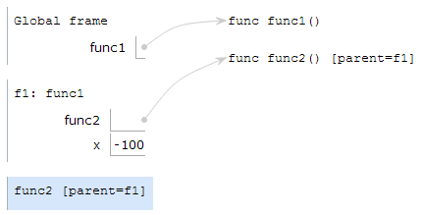
Nonlocal in Environment Diagrams
def func1():
x = -100
def func2():
nonlocal x
x = 3
func2()
func1()
If a variable is nonlocal, you must follow parents and look between (but not including) current frame and global.
3

Slide 56
Nonlocal in Environment Diagrams
def func1():
def func2():
x = 4
def func3():
def func4():
nonlocal x
x = 3
func4()
func3()
func2()
func1()
Does This Work?
Yes!

Slide 57
Nonlocal in Environment Diagrams
def func1():
def func2(x):
nonlocal x
x = 3
func2(4)
func1()
Does This Work?
No.
x is a local variable (in the same frame)

Slide 58
Nonlocal in Environment Diagrams
x = 50
def func1():
def func2():
nonlocal x
x = 3
func2()
func1()
Does This Work?
No.
x is in the global frame.

Slide 59
Draw the Environment Diagram
Challenge Problem
def k(b):
def seven(up):
b.extend(['<3','<3'])
nonlocal b
b = 5
up[0][0] = 'cs61a'
return up[0:2]
return seven((b, 3, 6))
k(['cookies'])

Slide 60
Environment Diagram Notes
Don't need nonlocal to mutate something!
def k(b):
def seven(up):
b.extend(['<3','<3'])
nonlocal b
b = 5
up[0][0] = 'cs61a'
return up[0:2]
return seven((b, 3, 6))
k(['cookies'])
Need nonlocal to change what value a variable points to
Slicing creates a new list with the same values.

Slide 61
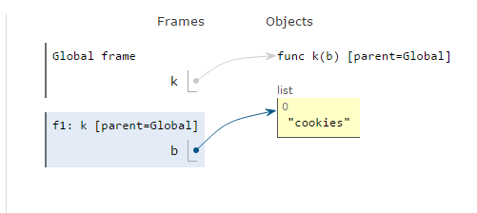
Draw the Environment Diagram
def k(b):
def seven(up):
b.extend(['<3','<3'])
nonlocal b
b = 5
up[0][0] = 'cs61a'
return up[0:2]
return seven((b, 3, 6))
k(['cookies'])

Slide 62
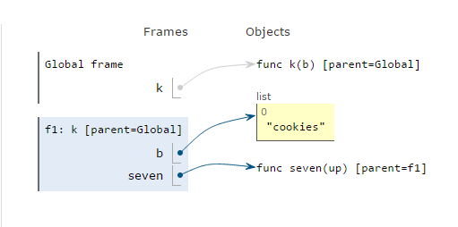
Draw the Environment Diagram
def k(b):
def seven(up):
b.extend(['<3','<3'])
nonlocal b
b = 5
up[0][0] = 'cs61a'
return up[0:2]
return seven((b, 3, 6))
k(['cookies'])

Slide 63
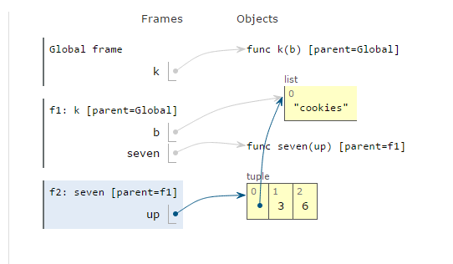
Draw the Environment Diagram
def k(b):
def seven(up):
b.extend(['<3','<3'])
nonlocal b
b = 5
up[0][0] = 'cs61a'
return up[0:2]
return seven((b, 3, 6))
k(['cookies'])

Slide 64
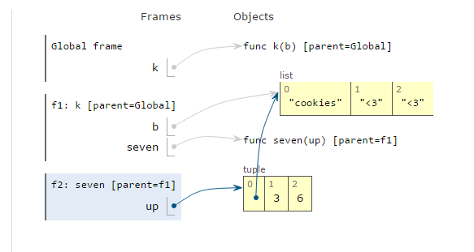
Draw the Environment Diagram
def k(b):
def seven(up):
b.extend(['<3','<3'])
nonlocal b
b = 5
up[0][0] = 'cs61a'
return up[0:2]
return seven((b, 3, 6))
k(['cookies'])

Slide 65
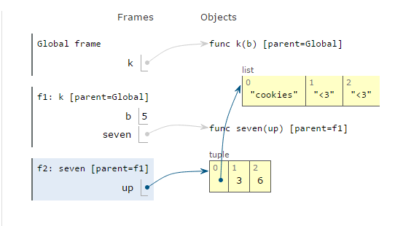
Draw the Environment Diagram
def k(b):
def seven(up):
b.extend(['<3','<3'])
nonlocal b
b = 5
up[0][0] = 'cs61a'
return up[0:2]
return seven((b, 3, 6))
k(['cookies'])

Slide 66
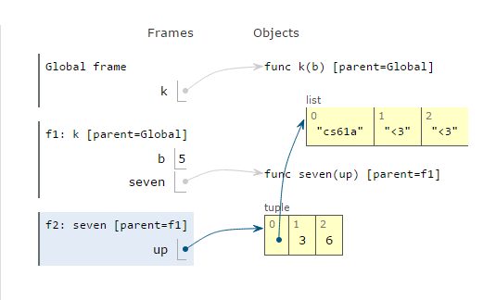
Draw the Environment Diagram
def k(b):
def seven(up):
b.extend(['<3','<3'])
nonlocal b
b = 5
up[0][0] = 'cs61a'
return up[0:2]
return seven((b, 3, 6))
k(['cookies'])

Slide 67
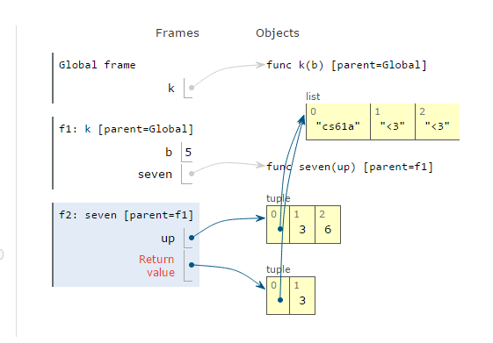
Draw the Environment Diagram
def k(b):
def seven(up):
b.extend(['<3','<3'])
nonlocal b
b = 5
up[0][0] = 'cs61a'
return up[0:2]
return seven((b, 3, 6))
k(['cookies'])

Slide 68
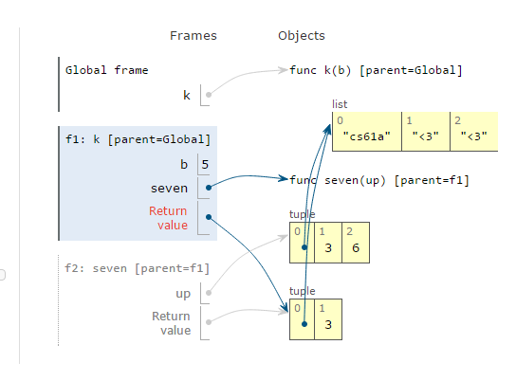
Draw the Environment Diagram
def k(b):
def seven(up):
b.extend(['<3','<3'])
nonlocal b
b = 5
up[0][0] = 'cs61a'
return up[0:2]
return seven((b, 3, 6))
k(['cookies'])

Slide 69
Nonlocal: Domo Population
Paul really likes Domos, so he buys n to start with. They multiply at the rate given by a function at every timestep. However, if the function does not increase the number of domos, use the most recent function that did. The starter function is lambda x: x * 2. When the number is greater than or equal to the capacity of his home, he gives 9/10 away to his beloved students. (It requires 1 timestep to give away 9/10 of the domos.)
def domo_population(n, capacity):
"""
>>> timestep = domo_population(5, 40)
>>> timestep(lambda x: x - 10)
10
>>> timestep(lambda x: x * 4)
40
>>> timestep(lambda x: x * 3)
4
"""

Slide 70
Nonlocal: Domo Population (Soln.)
def domo_population(n, capacity):
increase = lambda x: x * 2
def timestep(fn):
nonlocal increase, n
if fn(n) > n: # determine whether or not fn increases n
increase = fn
if n < capacity:
n = increase(n)
else:
n = n // 10 # don't increase if too many
return n
return timestep

Slide 71
Object-Oriented Programming

Slide 72
OOP: Person
>>> p = Person('John Denero', 8341)
# This calls __init__.
>>> p.greet()
"Hi, I'm John Denero"
>>> p.has_birthday()
8342
>>> Person.has_birthday()
has_birthday() missing 1 required argument: 'self'
>>> Person.has_birthday(p)
8343
>>> Person.num_people
1
>>> p.num_people
1
class Person(object):
num_people = 0
def __init__(self, name, age):
self.name = name
self.age = age
Person.num_people += 1
def has_birthday(self):
self.age = self.age + 1
return self.age
def greet(self):
return "Hi, I'm " + self.name

Slide 73
How Property Lookup Works
What does Python do when it sees “p.has_birthday”?
Checks if “has_birthday” is a property of the instance p
If not found in p, checks if it is a property of the class Person
If it finds “has_birthday” here and it is a function, it binds the first parameter (self) to p. The resulting function takes one less parameter and is called a “bound method”
If not found, raise AttributeError

Slide 74
How Property Lookup Works
What does Python do when it sees “Person.has_birthday”?
Checks if “has_birthday” is a property of the class Person
Even if it is a function, the first parameter is not bound to anything!
If not found, raise AttributeError

Slide 75
OOP: Person, revisited #1
>>> p = Person('John Denero', 8341)
# This calls __init__.
>>> p.greet()
"Hi, I'm John Denero"
>>> p.has_birthday()
8342
>>> Person.has_birthday()
has_birthday() missing 1 required argument: 'self'
>>> Person.has_birthday(p)
8343
p.has_birthday() and Person.has_birthday(p) do the same thing!
class Person(object):
num_people = 0
def __init__(self, name, age):
self.name = name
self.age = age
Person.num_people += 1
def has_birthday(self):
self.age = self.age + 1
return self.age
def greet(self):
return "Hi, I'm " + self.name

Slide 76
OOP: Person, revisited #2
>>> p = Person('John Denero', 8341)
# This calls __init__.
>>> p.has_birthday = Person.has_birthday
>>> p.has_birthday()
missing one required argument: ‘self’
Now, p’s “has_birthday” now points to the Person class’s “has_birthday” method. So the first parameter “self” is not bound after lookup
class Person(object):
num_people = 0
def __init__(self, name, age):
self.name = name
self.age = age
Person.num_people += 1
def has_birthday(self):
self.age = self.age + 1
return self.age
def greet(self):
return "Hi, I'm " + self.name

Slide 77
OOP: Person, revisited #3
>>> p = Person('John Denero', 8341)
# This calls __init__.
>>> Person.has_birthday = lambda: 3
>>> p.has_birthday()
<lambda>() takes 0 positional arguments but 1 was given
“p” is implicitly passed as the first argument, since it is bound as the first parameter.
But the function doesn’t take any arguments, so we get an error.
class Person(object):
num_people = 0
def __init__(self, name, age):
self.name = name
self.age = age
Person.num_people += 1
def has_birthday(self):
self.age = self.age + 1
return self.age
def greet(self):
return "Hi, I'm " + self.name

Slide 78
OOP: Person, revisited #4 (Tricky)
>>> p = Person('John Denero', 8341)
# This calls __init__.
>>> Person.has_birthday = p.has_birthday
>>> q = Person('Paul Hilfinger', 9000)
>>> q.has_birthday()
8342
Python keeps track of whether a function represents a “bound method” and won’t try to bind additional parameters
class Person(object):
num_people = 0
def __init__(self, name, age):
self.name = name
self.age = age
Person.num_people += 1
def has_birthday(self):
self.age = self.age + 1
return self.age
def greet(self):
return "Hi, I'm " + self.name

Slide 79
OOP: Plant
>>> p = Plant(10)
>>> p # repr example
Plant<10, 0>
>>> Plant.energy_for_leaf
10
>>> p.energy_for_leaf
_____
>>> p.if_sunny
_____
>>> p.photosynthesize
_____
>>> p.photo_fn
_____
>>> p.photosynthesize()
_____
>>> p
_____
>>> p.leaves
_____
>>> p
_____
sunny = True
class Plant:
energy_for_leaf = 10
def __init__(self, leaves, if_sunny=1.5, not_sunny=0.5):
self._leaves, self.energy = leaves, 0
self.photo_fn = lambda leaves, sunny: leaves * (if_sunny if sunny else not_sunny)
def photosynthesize(self):
self.energy += self.photo_fn(self.leaves, sunny)
@property
def leaves(self):
self.grow_leaves()
return self._leaves
def grow_leaves(self):
while self.energy > self.energy_for_leaf:
self._leaves += 1
self.energy -= self.energy_for_leaf
def __repr__(self):
return 'Plant<{}, {}>'.format(self._leaves, self.energy)

Slide 80
OOP: Plant
>>> p = Plant(10)
>>> p # repr example
Plant<10, 0>
>>> Plant.energy_for_leaf
10
>>> p.energy_for_leaf
10
>>> p.if_sunny
_____
>>> p.photosynthesize
_____
>>> p.photo_fn
_____
>>> p.photosynthesize()
_____
>>> p
_____
>>> p.leaves
_____
>>> p
_____
sunny = True
class Plant:
energy_for_leaf = 10
def __init__(self, leaves, if_sunny=1.5, not_sunny=0.5):
self._leaves, self.energy = leaves, 0
self.photo_fn = lambda leaves, sunny: leaves * (if_sunny if sunny else not_sunny)
def photosynthesize(self):
self.energy += self.photo_fn(self.leaves, sunny)
@property
def leaves(self):
self.grow_leaves()
return self._leaves
def grow_leaves(self):
while self.energy > self.energy_for_leaf:
self._leaves += 1
self.energy -= self.energy_for_leaf
def __repr__(self):
return 'Plant<{}, {}>'.format(self._leaves, self.energy)

Slide 81
OOP: Plant
sunny = True
class Plant:
energy_for_leaf = 10
def __init__(self, leaves, if_sunny=1.5, not_sunny=0.5):
self._leaves, self.energy = leaves, 0
self.photo_fn = lambda leaves, sunny: leaves * (if_sunny if sunny else not_sunny)
def photosynthesize(self):
self.energy += self.photo_fn(self.leaves, sunny)
@property
def leaves(self):
self.grow_leaves()
return self._leaves
def grow_leaves(self):
while self.energy > self.energy_for_leaf:
self._leaves += 1
self.energy -= self.energy_for_leaf
def __repr__(self):
return 'Plant<{}, {}>'.format(self._leaves, self.energy)
>>> p = Plant(10)
>>> p # repr example
Plant<10, 0>
>>> Plant.energy_for_leaf
10
>>> p.energy_for_leaf
10
>>> p.if_sunny
AttributeError
>>> p.photosynthesize
_____
>>> p.photo_fn
_____
>>> p.photosynthesize()
_____
>>> p
_____
>>> p.leaves
_____
>>> p
_____

Slide 82
OOP: Plant
>>> p = Plant(10)
>>> p # repr example
Plant<10, 0>
>>> Plant.energy_for_leaf
10
>>> p.energy_for_leaf
10
>>> p.if_sunny
AttributeError
>>> p.photosynthesize
<bound method at ...>
>>> p.photo_fn
_____
>>> p.photosynthesize()
_____
>>> p
_____
>>> p.leaves
_____
>>> p
_____
sunny = True
class Plant:
energy_for_leaf = 10
def __init__(self, leaves, if_sunny=1.5, not_sunny=0.5):
self._leaves, self.energy = leaves, 0
self.photo_fn = lambda leaves, sunny: leaves * (if_sunny if sunny else not_sunny)
def photosynthesize(self):
self.energy += self.photo_fn(self.leaves, sunny)
@property
def leaves(self):
self.grow_leaves()
return self._leaves
def grow_leaves(self):
while self.energy > self.energy_for_leaf:
self._leaves += 1
self.energy -= self.energy_for_leaf
def __repr__(self):
return 'Plant<{}, {}>'.format(self._leaves, self.energy)

Slide 83
OOP: Plant
>>> p = Plant(10)
>>> p # repr example
Plant<10, 0>
>>> Plant.energy_for_leaf
10
>>> p.energy_for_leaf
10
>>> p.if_sunny
AttributeError
>>> p.photosynthesize
<bound method at ...>
>>> p.photo_fn
<function at ...>
>>> p.photosynthesize()
_____
>>> p
_____
>>> p.leaves
_____
>>> p
_____
sunny = True
class Plant:
energy_for_leaf = 10
def __init__(self, leaves, if_sunny=1.5, not_sunny=0.5):
self._leaves, self.energy = leaves, 0
self.photo_fn = lambda leaves, sunny: leaves * (if_sunny if sunny else not_sunny)
def photosynthesize(self):
self.energy += self.photo_fn(self.leaves, sunny)
@property
def leaves(self):
self.grow_leaves()
return self._leaves
def grow_leaves(self):
while self.energy > self.energy_for_leaf:
self._leaves += 1
self.energy -= self.energy_for_leaf
def __repr__(self):
return 'Plant<{}, {}>'.format(self._leaves, self.energy)

Slide 84
OOP: Plant
sunny = True
class Plant:
energy_for_leaf = 10
def __init__(self, leaves, if_sunny=1.5, not_sunny=0.5):
self._leaves, self.energy = leaves, 0
self.photo_fn = lambda leaves, sunny: leaves * (if_sunny if sunny else not_sunny)
def photosynthesize(self):
self.energy += self.photo_fn(self.leaves, sunny)
@property
def leaves(self):
self.grow_leaves()
return self._leaves
def grow_leaves(self):
while self.energy > self.energy_for_leaf:
self._leaves += 1
self.energy -= self.energy_for_leaf
def __repr__(self):
return 'Plant<{}, {}>'.format(self._leaves, self.energy)
>>> p = Plant(10)
>>> p # repr example
Plant<10, 0>
>>> Plant.energy_for_leaf
10
>>> p.energy_for_leaf
10
>>> p.if_sunny
AttributeError
>>> p.photosynthesize
<bound method at ...>
>>> p.photo_fn
<function at ...>
>>> p.photosynthesize()
>>> p
_____
>>> p.leaves
_____
>>> p
_____

Slide 85
OOP: Plant
sunny = True
class Plant:
energy_for_leaf = 10
def __init__(self, leaves, if_sunny=1.5, not_sunny=0.5):
self._leaves, self.energy = leaves, 0
self.photo_fn = lambda leaves, sunny: leaves * (if_sunny if sunny else not_sunny)
def photosynthesize(self):
self.energy += self.photo_fn(self.leaves, sunny)
@property
def leaves(self):
self.grow_leaves()
return self._leaves
def grow_leaves(self):
while self.energy > self.energy_for_leaf:
self._leaves += 1
self.energy -= self.energy_for_leaf
def __repr__(self):
return 'Plant<{}, {}>'.format(self._leaves, self.energy)
>>> p = Plant(10)
>>> p # repr example
Plant<10, 0>
>>> Plant.energy_for_leaf
10
>>> p.energy_for_leaf
10
>>> p.if_sunny
AttributeError
>>> p.photosynthesize
<bound method at ...>
>>> p.photo_fn
<function at ...>
>>> p.photosynthesize()
>>> p
Plant<10, 15.0>
>>> p.leaves
_____
>>> p
_____

Slide 86
OOP: Plant
sunny = True
class Plant:
energy_for_leaf = 10
def __init__(self, leaves, if_sunny=1.5, not_sunny=0.5):
self._leaves, self.energy = leaves, 0
self.photo_fn = lambda leaves, sunny: leaves * (if_sunny if sunny else not_sunny)
def photosynthesize(self):
self.energy += self.photo_fn(self.leaves, sunny)
@property
def leaves(self):
self.grow_leaves()
return self._leaves
def grow_leaves(self):
while self.energy > self.energy_for_leaf:
self._leaves += 1
self.energy -= self.energy_for_leaf
def __repr__(self):
return 'Plant<{}, {}>'.format(self._leaves, self.energy)
>>> p = Plant(10)
>>> p # repr example
Plant<10, 0>
>>> Plant.energy_for_leaf
10
>>> p.energy_for_leaf
10
>>> p.if_sunny
AttributeError
>>> p.photosynthesize
<bound method at ...>
>>> p.photo_fn
<function at ...>
>>> p.photosynthesize()
>>> p
Plant<10, 15.0>
>>> p.leaves
11
>>> p
_____

Slide 87
OOP: Plant
sunny = True
class Plant:
energy_for_leaf = 10
def __init__(self, leaves, if_sunny=1.5, not_sunny=0.5):
self._leaves, self.energy = leaves, 0
self.photo_fn = lambda leaves, sunny: leaves * (if_sunny if sunny else not_sunny)
def photosynthesize(self):
self.energy += self.photo_fn(self.leaves, sunny)
@property
def leaves(self):
self.grow_leaves()
return self._leaves
def grow_leaves(self):
while self.energy > self.energy_for_leaf:
self._leaves += 1
self.energy -= self.energy_for_leaf
def __repr__(self):
return 'Plant<{}, {}>'.format(self._leaves, self.energy)
>>> p = Plant(10)
>>> p # repr example
Plant<10, 0>
>>> Plant.energy_for_leaf
10
>>> p.energy_for_leaf
10
>>> p.if_sunny
AttributeError
>>> p.photosynthesize
<bound method at ...>
>>> p.photo_fn
<function at ...>
>>> p.photosynthesize()
>>> p
Plant<10, 15.0>
>>> p.leaves
11
>>> p
Plant<11, 5.0>

Slide 88
Inheritance

Slide 89
Inheritance: Example
class Person(object):
def __init__(self, name, age):
self.name = name
self.age = age
def has_birthday(self):
self.age = self.age + 1
return self.age
def greet(self):
return "Hi, I'm " + self.name
class Fireman(object):
def __init__(self, name, age, fid):
self.name = name
self.age = age
self.fid = fid
def has_birthday(self):
self.age = self.age + 1
return self.age
def greet(self):
return "Hi, I'm " + self.name
def put_out_fire(self):
print(‘PUTTING OUT FIRE!’)

Slide 90
Inheritance: Example
class Person(object):
def __init__(self, name, age):
self.name = name
self.age = age
def has_birthday(self):
self.age = self.age + 1
return self.age
def greet(self):
return "Hi, I'm " + self.name
class Fireman(object):
def __init__(self, name, age, fid):
self.name = name
self.age = age
self.fid = fid
def has_birthday(self):
self.age = self.age + 1
return self.age
def greet(self):
return "Hi, I'm " + self.name
def put_out_fire(self):
print(‘PUTTING OUT FIRE!’)
How can we use the concept of inheritance to improve our Fireman class?

Slide 91
Inheritance: Better Example
class Fireman(Person):
def __init__(self, name, age, fid):
Person.__init__(self, name, age)
self.fid = fid
def put_out_fire(self):
print(‘PUTTING OUT FIRE!’)
class Person(object):
def __init__(self, name, age):
self.name = name
self.age = age
def has_birthday(self):
self.age = self.age + 1
return self.age
def greet(self):
return "Hi, I'm " + self.name
>>> f = Fireman('John DeNero', 8341, 1)
>>> f.name
'John DeNero'
>>> f.has_birthday()
8342
>>> f.put_out_fire()
PUTTING OUT FIRE!

Slide 92
Jedi
class Jedi(object):
def __init__(self, name, lightsaber_color, ls_power):
self.name = name
self.ls_color = lightsaber_color
self.ls_power = ls_power
def lightsaber_duel(self, other_jedi):
if self.ls_power > other_jedi.ls_power:
print(self.name + ‘ defeated ’ + other_jedi.name)
elif self.ls_power == other_jedi.ls_power:
print(‘Tie!’)
else:
print(self.name + ‘ has fallen to ’ + other_jedi.name)

Slide 93
DarkJedi
class Jedi(object):
def __init__(self, name, lightsaber_color, ls_power):
self.name = name
self.ls_color = lightsaber_color
self.ls_power = ls_power
def lightsaber_duel(self, other_jedi):
…
class DarkJedi(Jedi):
def __init__(self, name, lightsaber_color, ls_power, evil_power):
"*** YOUR CODE HERE ***"
def use_power(self):
print(self.evil_power)
def lightsaber_duel(self, other_jedi):
"*** YOUR CODE HERE ***"

Slide 94
DarkJedi
class Jedi(object):
def __init__(self, name, lightsaber_color, ls_power):
self.name = name
self.ls_color = lightsaber_color
self.ls_power = ls_power
def lightsaber_duel(self, other_jedi):
…
class DarkJedi(Jedi):
def __init__(self, name, lightsaber_color, ls_power, evil_power):
Jedi.__init__(self, name, lightsaber_color, ls_power)
self.evil_power = evil_power
def use_power(self):
print(self.evil_power)
def lightsaber_duel(self, other_jedi):
Jedi.lightsaber_duel(self, other_jedi)

Slide 95
DarkJedi
class DarkJedi(Jedi):
def __init__(self, name, lightsaber_color, ls_power, evil_power):
Jedi.__init__(self, name, lightsaber_color, ls_power)
self.evil_power = evil_power
def use_power(self):
print(self.evil_power)
def lightsaber_duel(self, other_jedi):
Jedi.lightsaber_duel(self, other_jedi)
Do we need this?

Slide 96
DarkJedi
class DarkJedi(Jedi):
def __init__(self, name, lightsaber_color, ls_power, evil_power):
Jedi.__init__(self, name, lightsaber_color, ls_power)
self.evil_power = evil_power
def use_power(self):
print(self.evil_power)
def lightsaber_duel(self, other_jedi):
Jedi.lightsaber_duel(self, other_jedi)
Do we need this?
Nope! It is inherited from Jedi.

Slide 97
Facepalm
It is 2001 and you are a college student at Cal. You decide to create Facepalm, an application for the Palm Pilot that maintains information about different people in your address book.
Facepalm will have a Profile for each person. You decide to write a class called Profile that simulates a Facepalm profile. It stores a person's name, the person's institution, and a list of Profiles of the person's friends. It also has the add_friend(profile) method, which adds the given profile to the list of friends’ Profiles, if profile is not already present.

Slide 98
Facepalm - Solution
class Profile(object):
def __init__(self, name, inst):
"*** YOUR CODE HERE ***"
def add_friend(self, profile):
"*** YOUR CODE HERE ***"

Slide 99
Facepalm - Solution
class Profile(object):
def __init__(self, name, inst):
self.name = name
self.inst = inst
self.friends = []
def add_friend(self, profile):
if profile not in self.friends:
self.friends.append(profile)

Slide 100
Facepalm … with profit
You aren’t exactly raking in the money that you were expecting from the app. To try to get some revenue, you decide that profiles will be restricted by default. A restricted profile can only add 100 friends, beyond which they are not able to add more friends. If a person tries to add more friends when they have 100 already, you should tell them to upgrade to PaidProfiles, which lift this restriction.
Modify Profile.add_friend to implement this restriction. Also define another class PaidProfile to mimic the Profile class, except in the behavior of the add_friend method.

Slide 101
Facepalm … with profit
class Profile(object):
def __init__(self, name, inst):
self.name = name
self.inst = inst
self.friends = []
def add_friend(self, profile):
"*** YOUR CODE HERE ***"
class PaidProfile(Profile):
"*** YOUR CODE HERE ***"

Slide 102
Facepalm … with profit - Solution
class Profile(object):
...
def add_friend(self, profile):
if profile not in self.friends:
if len(self.friends) < 100:
self.friends.append(profile)
else:
print(“You have 100 friends, please upgrade!”)
class PaidProfile(Profile):
def add_friend(self, profile): if profile not in self.friends:
self.friends.append(profile)

Slide 103

Next Topic: Linked Lists

Slide 104
Linked Lists
Wikipedia: a linked list is a linear collection of data elements, called nodes, each pointing to the next node by means of a pointer

Slide 105
Linked Lists
class Link: """A linked list with a first element and the rest.""" empty = () def __init__(self, first, rest=empty): assert rest is Link.empty or isinstance(rest, Link) self.first = first self.rest = rest def __getitem__(self, i): if i == 0: return self.first else: return self.rest[i-1] def __len__(self): return 1 + len(self.rest)

Slide 106

Linked Lists
class Link: """A linked list with a first element and the rest.""" empty = () def __init__(self, first, rest=empty): assert rest is Link.empty or isinstance(rest, Link) self.first = first self.rest = rest def __getitem__(self, i): if i == 0: return self.first else: return self.rest[i-1] def __len__(self): return 1 + len(self.rest)
Make an Linked List with a 2 in it?
Link(2)
A Linked List with 1 then 2 in it?
Link(1, Link(2))

Slide 107
Linked Lists
r = Link(1, Link(2, Link(3)))
How do we retrieve the 1?
r.first
Retrieve the 2?
r.rest.first

Slide 108
Linked Lists
Write reduce:
def reduce(lst, combiner, default):
"""
>>> r = Link(1, Link(2, empty))
>>> reduce(r, lambda x, y: x + y, 0)
3
"""

Slide 109
Linked Lists
Write reduce:
def reduce(lst, combiner, default):
if lst is Link.empty:
return default
return combiner(lst.first,
reduce(lst.rest, combiner, default))

Slide 110
Linked Lists
Define a procedure skip_consecutives that, given an Rlist of numbers, removes the consecutive duplicates with mutation.
def skip_consecutives(r):
"""
>>> r = Link(1, Link(1, Link(3,
Link(2, Link(1))))
>>> skip_consecutives(r)
# r is now Link(1, Link(3, Link(2, Link(1))))
"""

Slide 111
Linked Lists
Define a procedure skip_consecutives that, given a Linked List of numbers, removes the consecutive duplicates with mutation.
def skip_consecutives(r):
if r is Link.empty:
return
current = r.rest
while current is not Link.empty and r.first == current.first:
r.rest = r.rest.rest
current = r.rest
skip_consecutives(r.rest)

Slide 112
Linked Lists
Define a procedure map_linkify that, given a regular list and a function, returns a linked list version of the regular list with the function applied to all values.
def map_linkify(lst, f):
"""
>>> lst = [1, 2, 3]
>>> f = lambda x: x + 1
>>> r = map_linkify(lst, f)
>>> r
Link(2, Link(3, Link(4)))
"""

Slide 113
Linked Lists
def map_linkify(lst, f):
if not lst:
return Link.empty
else:
return Link(f(lst[0]),
map_linkify(lst[1:], f))

Slide 114
Linked Lists: Challenge Question
You have a linked list (the object-based version). What is the most efficient way to find the middle element (assume of the linked list has odd length)?

Slide 115
Linked Lists: Challenge Question
You have a linked list (the object-based version). What is the most efficient way to find the middle element?
Answer: Keep two pointers. Iterate one pointer two nodes at a time, but iterate the other only one node at a time. When the first node hits the end of the list, the second hits the middle element. (This is a popular interview question!)

Slide 116

Next Topic: Trees

Slide 117
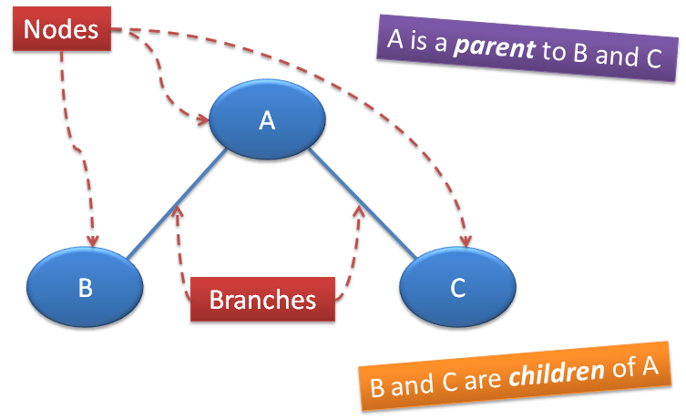
Trees: Review

Slide 118
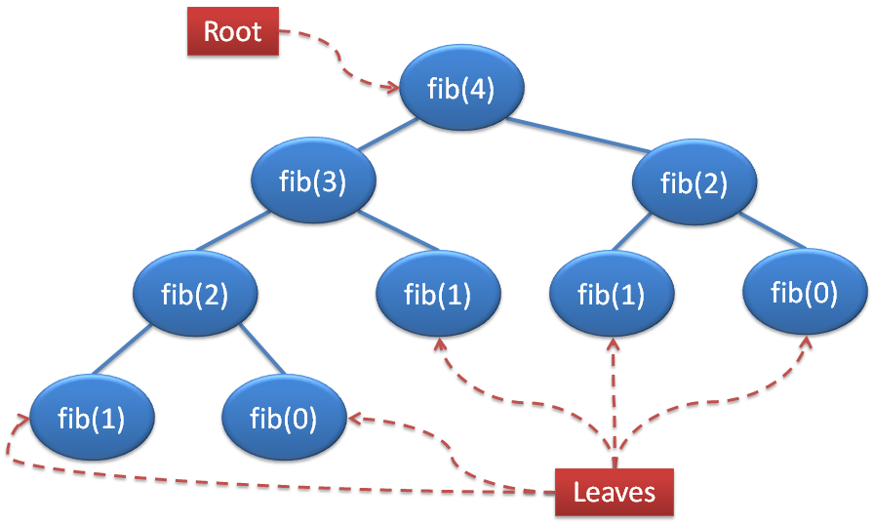
Trees: Review

Slide 119
Trees: Review
class Tree: def __init__(self, entry, branches=()): self.entry = entry for branch in branches: assert isinstance(branch, Tree) self.branches = branches
def __repr__(self): if self.branches: return 'Tree({0}, {1})'.format(self.entry, repr(self.branches)) else: return 'Tree({0})'.format(repr(self.entry))
def is_leaf(self): return not self.branches

Slide 120
Trees: Review
class BTree(Tree):
empty = Tree(None)
empty.is_empty = True
def __init__(self, entry, left=empty, right=empty): for branch in (left, right):
assert isinstance(branch, BTree) or branch.is_empty
Tree.__init__(self, entry, (left, right))
self.is_empty = False
@property
def left(self):
return self.branches[0]
@property
def right(self):
return self.branches[1]

Slide 121
Trees: Review
Notice that trees are also recursively defined.
A tree is made from other trees –
these trees are its subtrees.
Thus, a general strategy to write functions that operate on tree problems is recursively:
Apply the function on the subtrees and
combine the results in a relevant way.

Slide 122
Trees
Write a function dohn_finder that takes in a tree and returns whether it contains the string “JeNero”:
>>> dohn_finder(Tree(“JeNero”, (Tree(“Hilfinger”)))
True
>>> dohn_finder(Tree(“mank demes”))
False
def dohn_finder(t):
***YOUR CODE HERE***

Slide 123
Trees
def dohn_finder(t):
if t.entry == “JeNero”:
return True
for b in t.branches:
if dohn_finder(b):
return True
return False

Slide 124
Trees
Write the function prod_tree, which takes a Tree of numbers and returns the product of all the numbers in the Tree.
>>> t = Tree(1, Tree(2), Tree(3, Tree(4,
Tree(5),
Tree(6))))
>>> prod_tree(t)
720

Slide 125
Trees
Write the function prod_tree, which takes a Tree of numbers and returns the product of all the numbers in the Tree.
def prod_tree(t):
result = t.entry
for branch in t.branches:
result *= prod_tree(branch)
return result

Slide 126
Trees (Binary: HARD!)
Write a function all_paths that takes in a BTree and returns a list of tuples, where each nested tuple is a path from the root to a leaf.
>>> all_paths(t)
[(1, 2, 3), (1, 2, 4), (1, 5, 6), (1, 5, 7)]

Slide 127
Trees (Binary: HARD!)
1
2
5
3
4
6
7
>>> all_paths(t)
[(1, 2, 3), (1, 2, 4), (1, 5, 6), (1, 5, 7)]

Slide 128
Trees (Binary: HARD!)
def all_paths(t):
if t is BTree.empty:
return []
if t.branches == ():
return [(t.entry,)]
paths_in_left = all_paths(t.left)
paths_in_right = all_paths(t.right)
result = []
for path in paths_in_left + paths_in_right:
result.append((t.entry,) + path)
return result

Slide 129

Next Topic: Orders of Growth

Slide 130
Orders of Growth: Review
Way of expressing how long a function/program takes to execute in terms of the size of its input as it grows very large (given as a variable, usually n).
Big Ө Notation: Throw away constants in front of variable:
25n² ---> Ө(n²)

Slide 131
Orders of Growth
Keep in mind what happens as n grows large.
What is the order of growth for this function?
def func(n):
for i in range(n // 2):
print(i)
return n

Slide 132
Orders of Growth
Keep in mind what happens as n grows large.
What is the order of growth for this function?
def func(n):
for i in range(n // 2):
print(i)
return n
Ө(n)

Slide 133
Orders of Growth
What is the order of growth for this function?
def denero(denero):
denero = 5 * denero
john = denero ** 2
while (john > 0): print (“Announcements!”)
john = john - 1

Slide 134
Orders of Growth
What is the order of growth for this function?
def denero(denero):
denero = 5 * denero
john = denero ** 2
while (john > 0): print (“Announcements!”)
john = john - 1
Ө(denero²)

Slide 135
Orders of Growth
What is the order of growth for this function?
def doge(n):
if n <= 1:
print (“Wow”)
return n
return doge(n - 1) + doge(n - 2)

Slide 136

Orders of Growth
What is the order of growth for this function?
def doge(n):
if n <= 1:
print (“Much wow”)
return n
return doge(n - 1) + doge(n - 2)
Ө(2^{n})

Slide 137
Orders of Growth
What is the order of growth for this function?
def func(n):
if n <= 1:
return n
return 1 + func(n // 2)

Slide 138
Orders of Growth
What is the order of growth for this function?
def func(n):
if n <= 1:
return n
return 1 + func(n // 2)
Ө(log n)

Slide 139
Orders of Growth
What is the order of growth for this function?
def func(n):
if n <= 1:
return 1
if n <= 50:
return func(n - 1) + func(n - 2)
elif n > 50:
return func(50) + func(49)

Slide 140
Orders of Growth
What is the order of growth for this function?
def func(n):
if n <= 1:
return 1
if n <= 50:
return func(n - 1) + func(n - 2)
elif n > 50:
return func(50) + func(49)
Ө(1)

Slide 141
Orders of Growth
What is the order of growth for this function?
def func(n):
lst = []
for i in range(n):
lst.append(i)
# Order of growth of ‘append’ is O(1) in the length of the list.
if n <= 1:
return 1
if n <= 50:
return func(n - 1) + func(n - 2)
elif n > 50:
return func(50) + func(49)

Slide 142
Orders of Growth
What is the order of growth for this function?
def func(n):
lst = []
for i in range(n):
lst.append(i)
# Order of growth of ‘append’ is O(1) in the length of the list.
if n <= 1:
return 1
if n <= 50:
return func(n - 1) + func(n - 2)
elif n > 50:
return func(50) + func(49)
Ө(n)

Slide 143
Orders of Growth
def foo(x, y):
if x == 0:
return 1
if y > 0:
return foo(x, y - 1)
return 1 + foo(x // 2, y)
What is the order of growth in time for foo(x, baz(y)) with respect to x?
What is the order of growth in time for foo(x, baz(y)) with respect to y?
def baz(z):
return abs(z)

Slide 144
Orders of Growth
def foo(x, y):
if x == 0:
return 1
if y > 0:
return foo(x, y - 1)
return 1 + foo(x // 2, y)
What is the order of growth in time for foo(x, baz(y)) with respect to x?
Ө(log x)
What is the order of growth in time for foo(x, baz(y)) with respect to y?
def baz(z):
return abs(z)

Slide 145
Orders of Growth
def foo(x, y):
if x == 0:
return 1
if y > 0:
return foo(x, y - 1)
return 1 + foo(x // 2, y)
What is the order of growth in time for foo(x, baz(y)) with respect to x?
Ө(log x)
What is the order of growth in time for foo(x, baz(y)) with respect to y?
Ө(y)
def baz(z):
return abs(z)

Slide 146
Orders of Growth
def foo(x, y):
if x == 0:
return 1
if y > 0:
return foo(x, y - 1)
return 1 + foo(x // 2, y)
What is the order of growth in time for foo(x, baz(y)) with respect to x?
Ө(log x)
What is the order of growth in time for foo(x, baz(y)) with respect to y?
Ө(y)
What is the order of growth in time for foo(x, baz(y)) with respect to x and y?
def baz(z):
return abs(z)

Slide 147
Orders of Growth
def foo(x, y):
if x == 0:
return 1
if y > 0:
return foo(x, y - 1)
return 1 + foo(x // 2, y)
What is the order of growth in time for foo(x, baz(y)) with respect to x?
Ө(log x)
What is the order of growth in time for foo(x, baz(y)) with respect to y?
Ө(y)
What is the order of growth in time for foo(x, baz(y)) with respect to x and y?
Ө(log(x) + y)
def baz(z):
return abs(z)

Slide 148
Feedback
We would like your feedback on this review session, so that we can improve for future review sessions. This is completely optional.
If you would like to provide suggestions, complaints or comments, please fill out hkn.mu/feedback .
Thanks for coming, and best of luck on your midterm!

